Slide 1
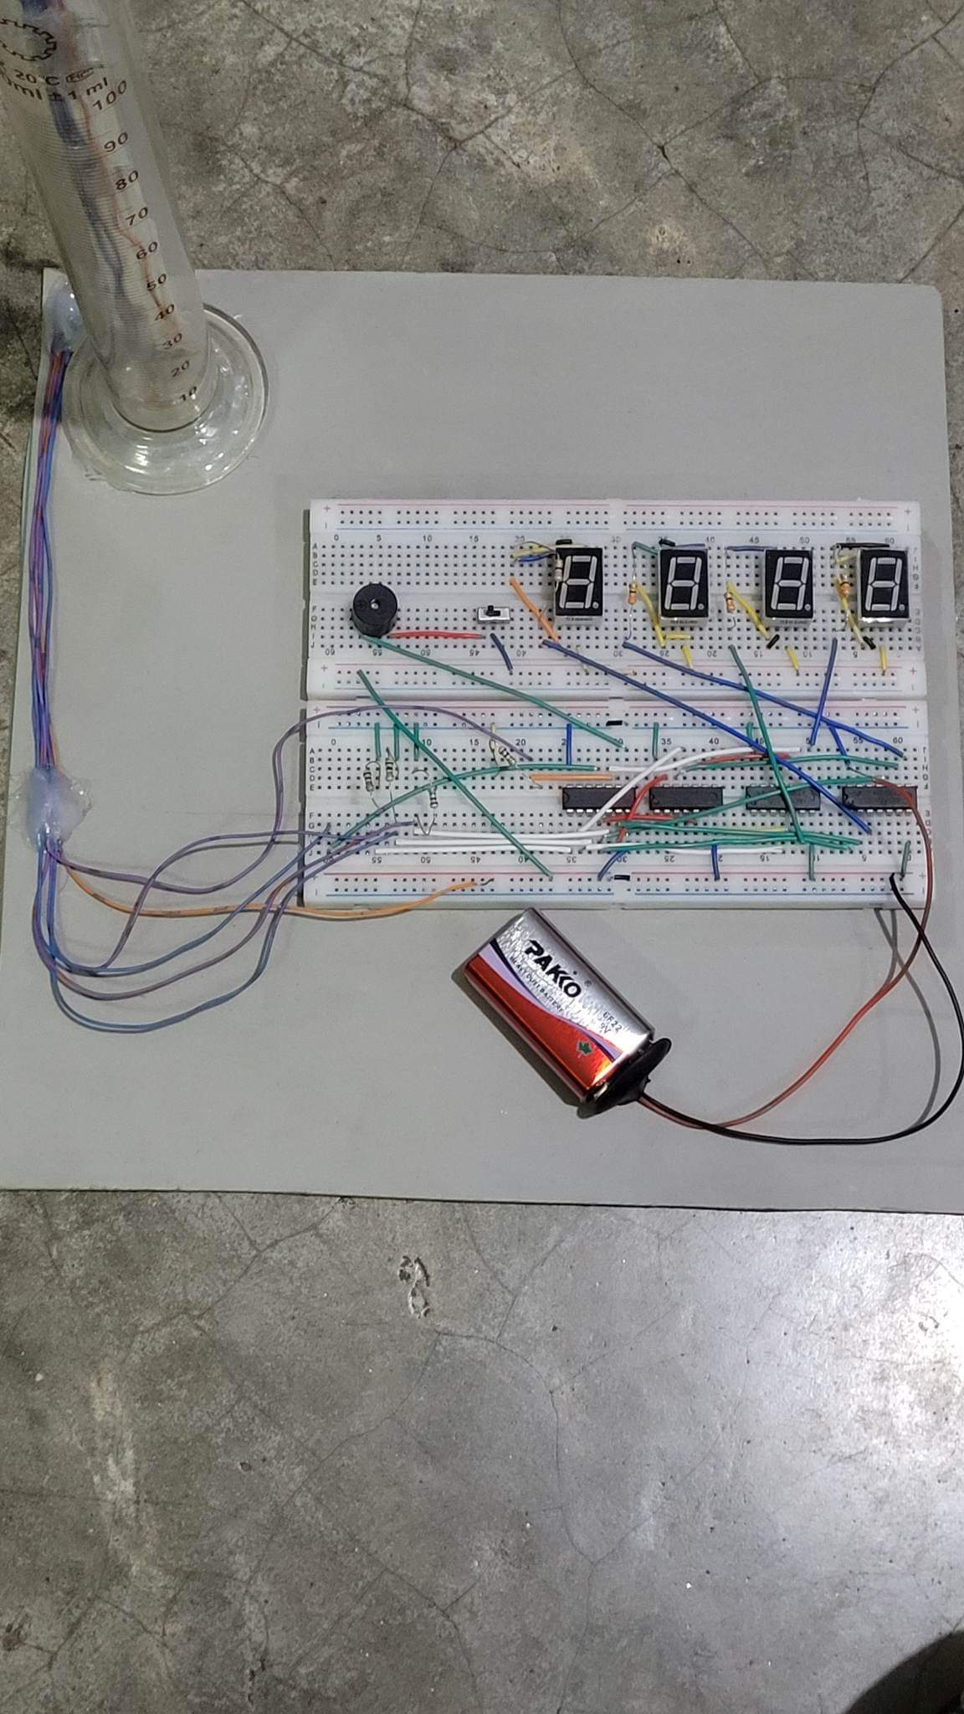




Water Level Indicator Using 74 Series IC and 7 Segment Display
Submitted by – Group C2.04
Moytri Ghosal
1806167
Sandipa Chowdhury
1806168
Sudipto Pramanik
1806172
Tusher Karmakar
1806174

Slide 2
Outline
Summary
Introduction
Design
Implementation
Analysis and Evaluation
References
Presented by: 1806174

Slide 3
Water Level Indicator Using 74 Series IC and 7 Segment Display
Summary
Acknowledgement and References
Introduction
Technical Details of Design
Limitations and Practical Considerations
Reflection on Individual and Teamwork
Demonstration

Slide 4
Water Level Indicator Using 74 Series IC and 7 Segment Display
Summary
Acknowledgement and References
Introduction
Technical Details of Design
Limitations and Practical Considerations
Reflection on Individual and Teamwork
Demonstration

Slide 5
1. Summary
1) Simple mechanism to indicate the level
2)When the water level is empty it shows E
3)If the water level is at 5% the transition goes to L from E
4)If the water level is at 65% the transition goes to H from L
5)If the water level is at 90% the transition goes to F from H
6)If the water level is at 100% there is sound of buzzer.
Presented by: 1806174

Slide 6
Water Level Indicator Using 74 Series IC and 7 Segment Display
Summary
Acknowledgement and References
Introduction
Technical Details of Design
Limitations and Practical Considerations
Reflection on Individual and Teamwork
Demonstration

Slide 7
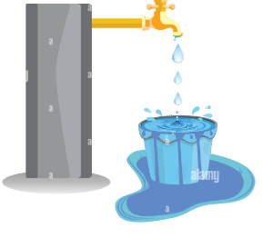
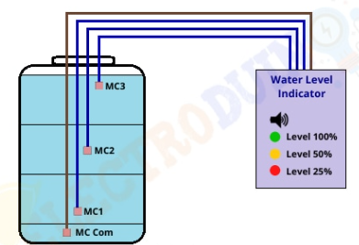
2. Introduction
Designed to deal with the water level problem using basic logic ICs.
Small in size
Further modification can also be mad it possible as flood indicator.
Can be used in factories, households , water storage tanks .
Presented by: 1806174

Slide 8
2.1 Complexity Analysis
Can be further modified with automated on-off system .
The water here can be a source of conductance .
If BJTs are used then this characteristics of water will be used to switch on /off these as switches .
Presented by: 1806174

Slide 9
Water Level Indicator Using 74 Series IC and 7 Segment Display
Summary
Acknowledgement and References
Introduction
Technical Details of Design
Limitations and Practical Considerations
Reflection on Individual and Teamwork

Slide 10
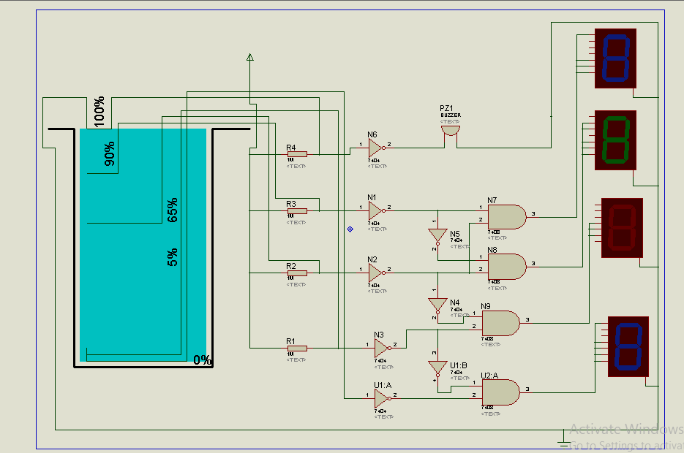
3.1 Design: Circuit Diagram(simulation)
Presented by: 1806172

Slide 11
3.2 Design: Methods
Components used :
1) 7404 Ics
2)7408 Ics
3) Testube
4)Wires
5) Seven segment display.
Presented by: 1806172

Slide 12
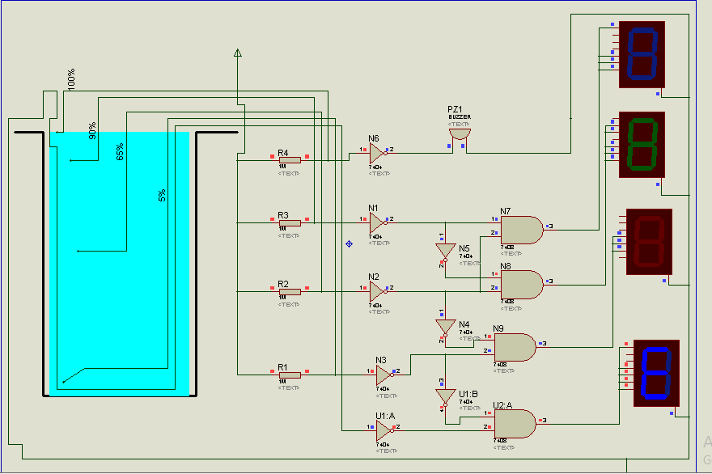
Design:Methods(When Tank Is Empty)

Slide 13
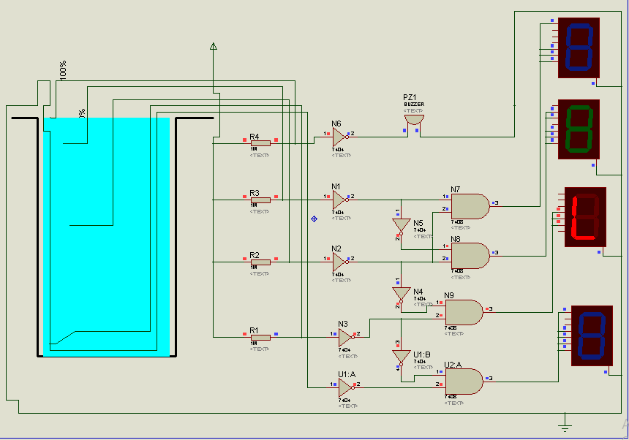
Design:Methods(When Tank Is LOW)

Slide 14
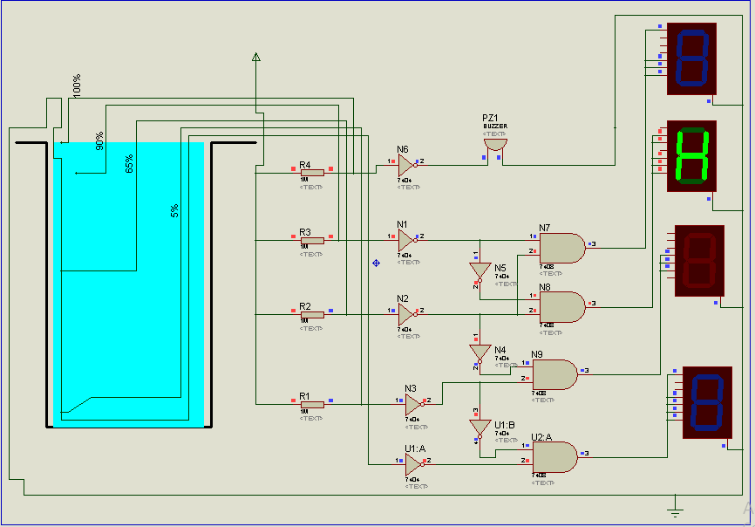
Design:Methods(When Tank Is High)

Slide 15
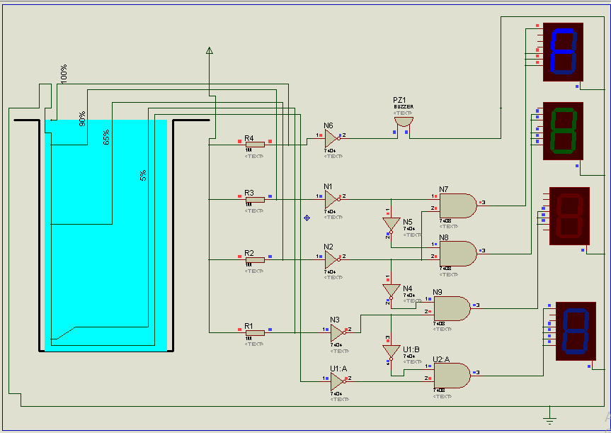
Design:Methods(When Tank Is Full)

Slide 16
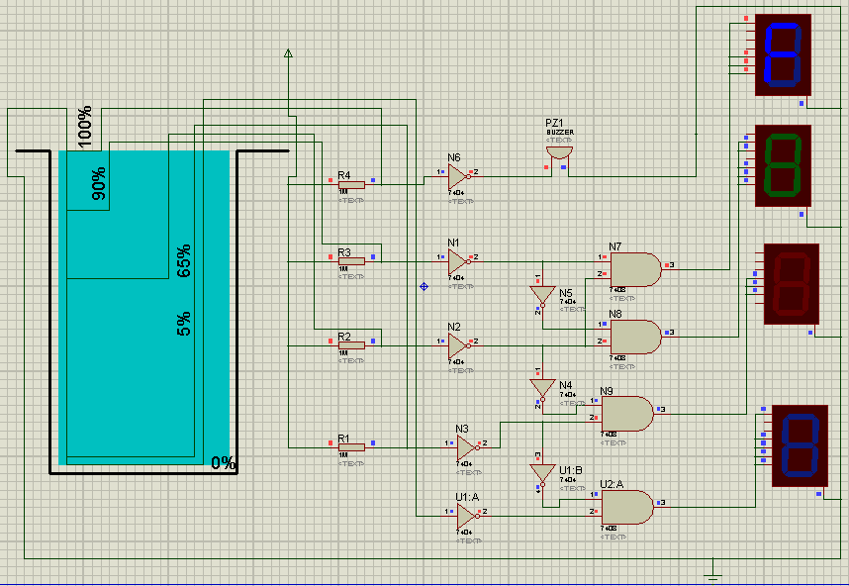
Design:Methods(When Tank Is Overflowed)

Slide 17
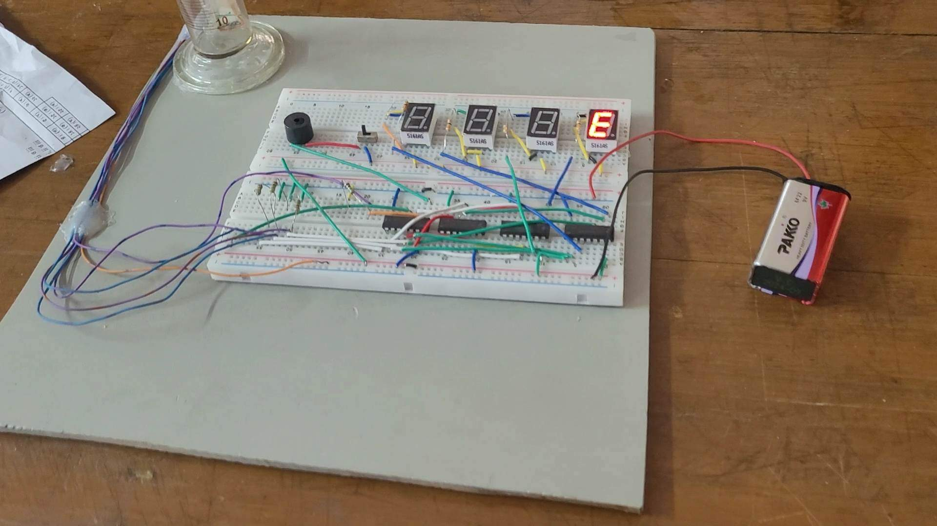
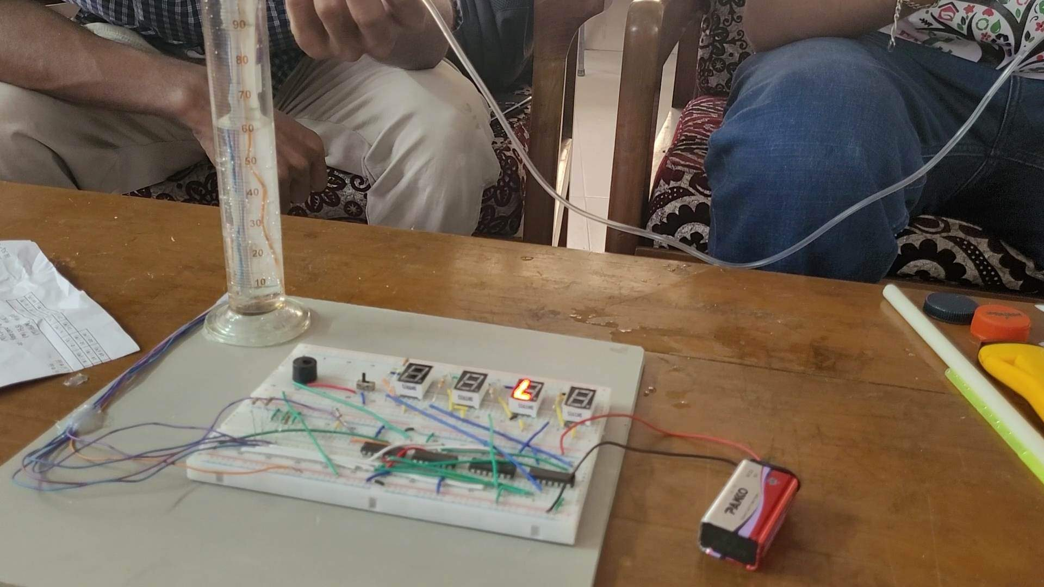
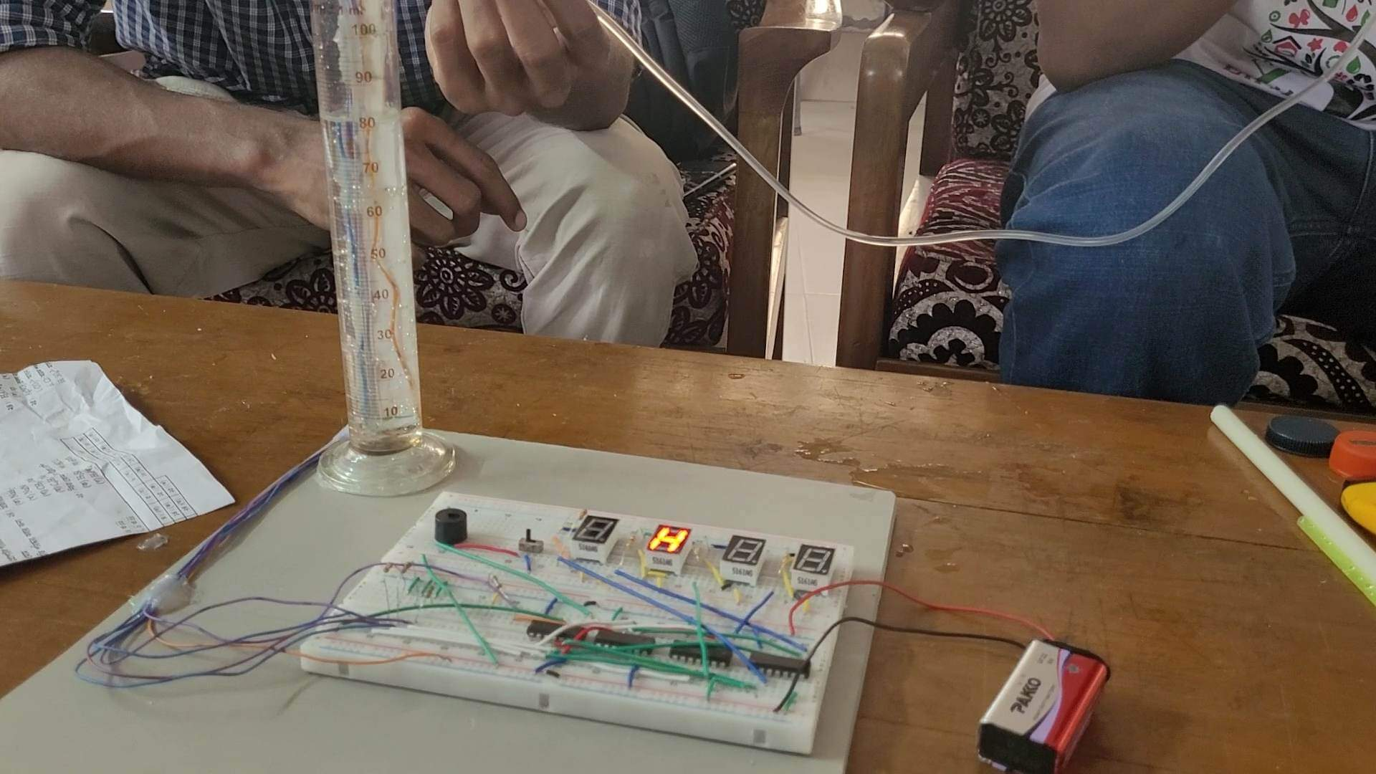
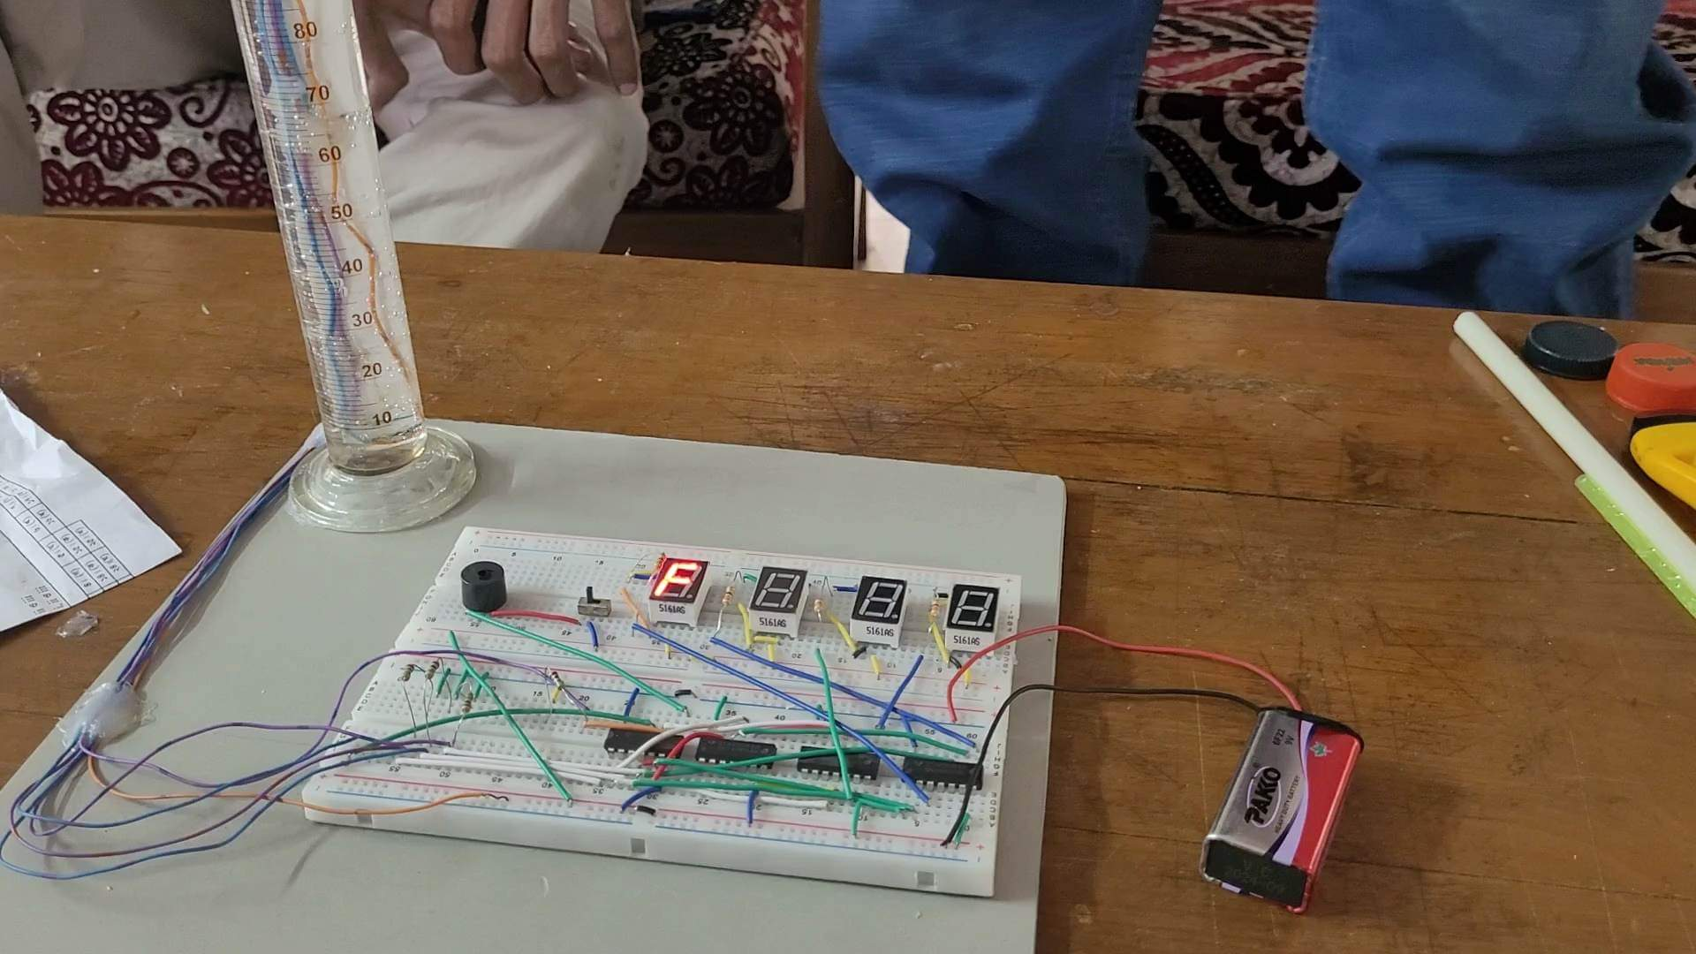
3.4.1 Implementation: Photo Gallary
Presented by: 1806172

Slide 18
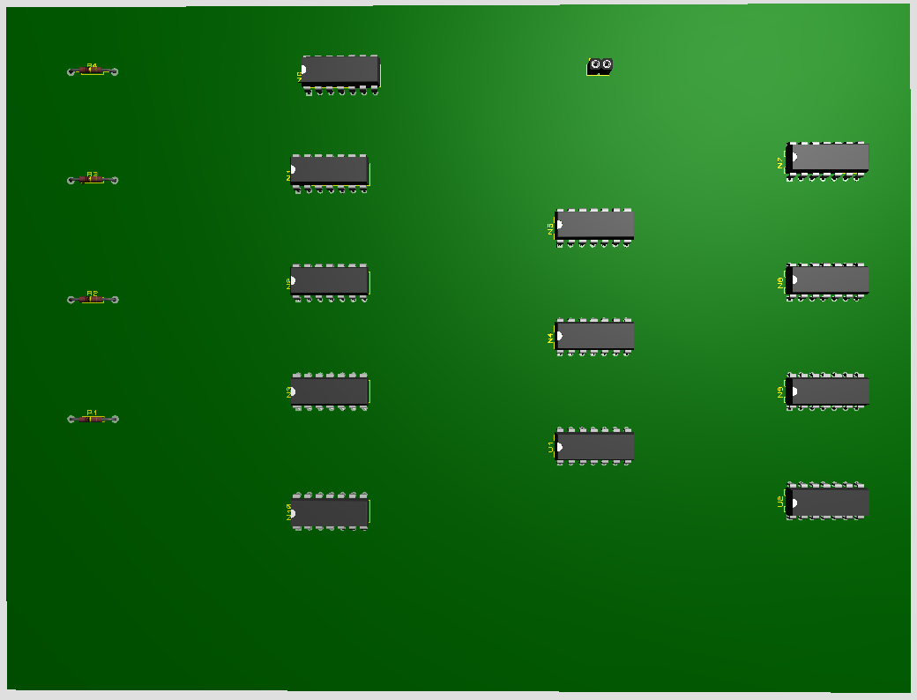
3.4.2 Design:PCB Layout and 3d rendering

Slide 19

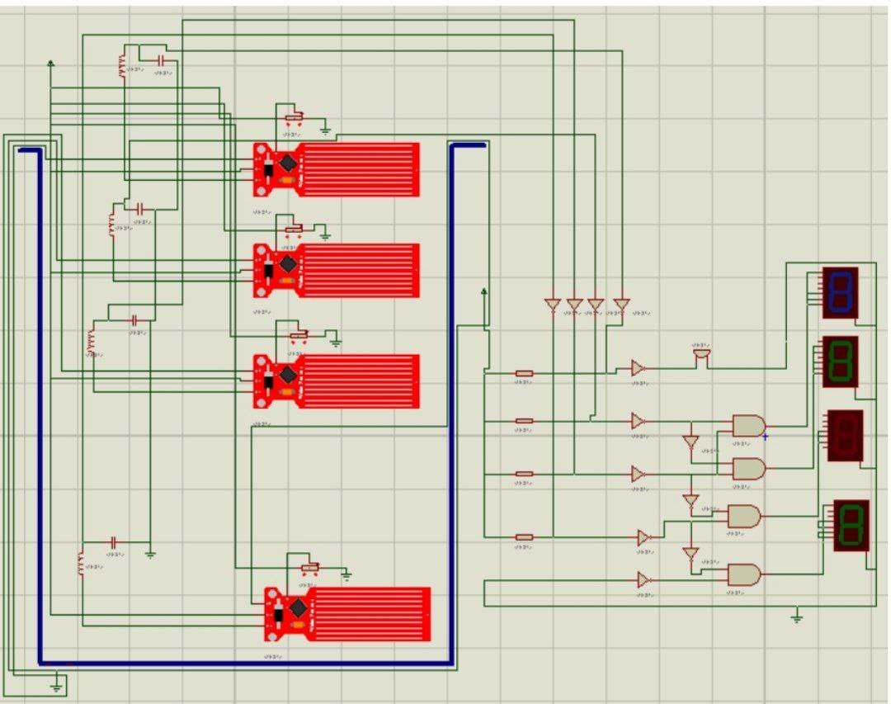
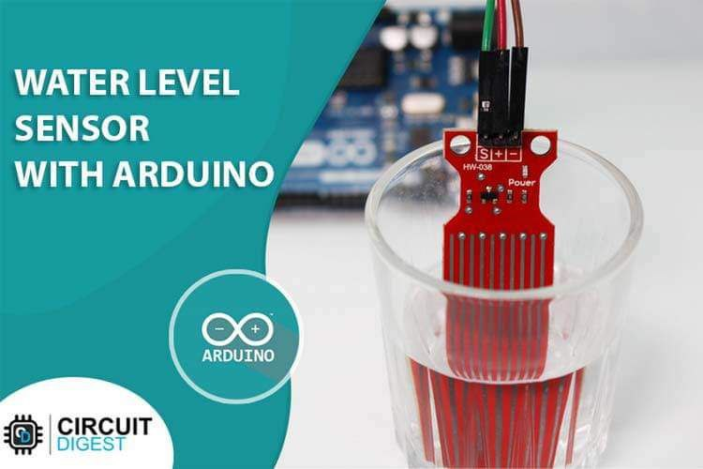
3.5 Simulation Results / Bench Mark
Presented by: 1806172

Slide 20
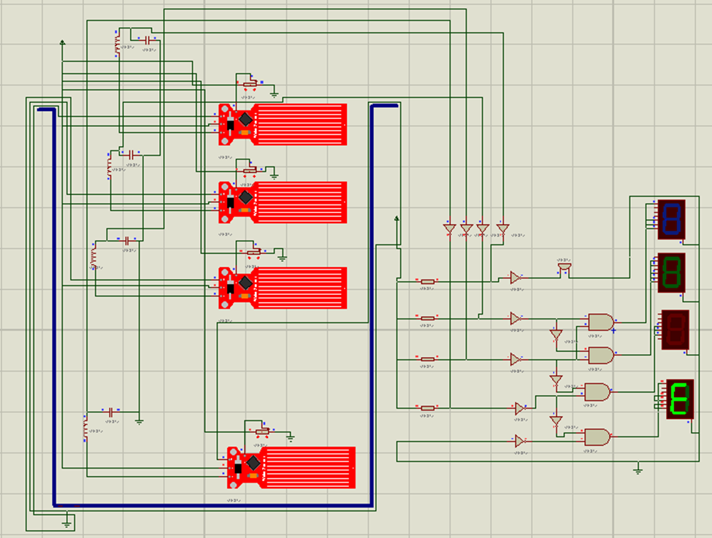
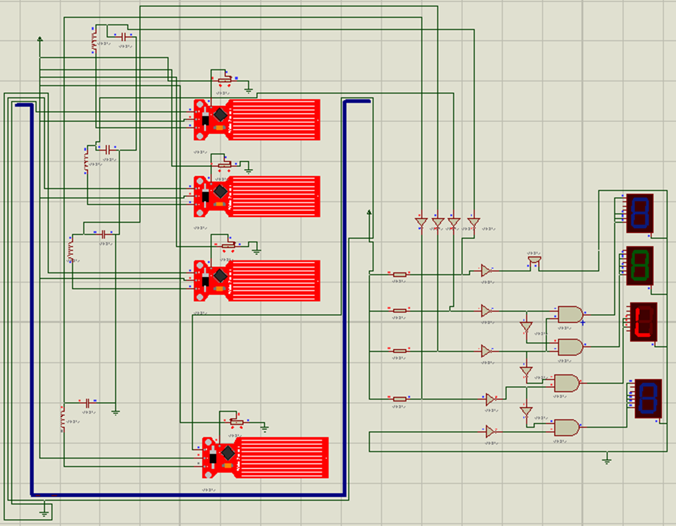
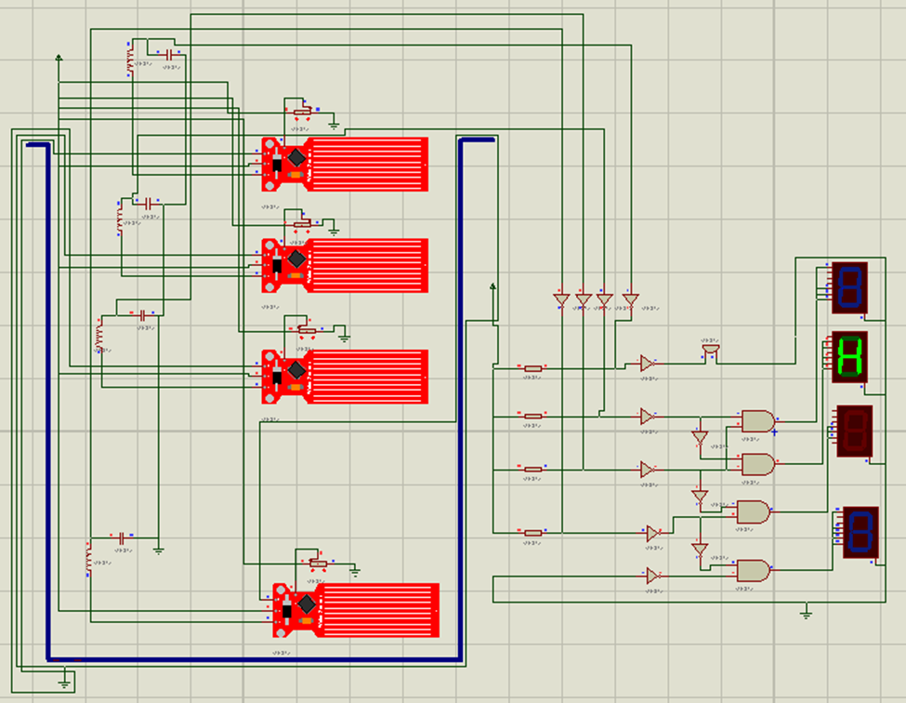


Slide 21
Water Level Indicator Using 74 Series IC and 7 Segment Display
Summary
Acknowledgement and References
Introduction
Technical Details of Design
Limitations and Practical Considerations
Reflection on Individual and Teamwork
Demonstration

Slide 22
Demonstration Video
https://youtu.be/Qdus7yexIbQ
Presented by: 1806168

Slide 23
Water Level Indicator Using 74 Series IC and 7 Segment Display
Summary
Acknowledgement and References
Introduction
Technical Details of Design
Limitations and Practical Considerations
Reflection on Individual and Teamwork
Demonstration

Slide 24
4. Limitations and Practical Considerations 4.1Limitations
Didn't use water level sensor
It's a miniature version

Slide 25
4.2.1 Practical Considerations: Public Health and Safety
Observing water level in
1)water treatment plants
2)Swimming pools
Presented by: 1806168

Slide 26
4.2.2 Practical Considerations: Environment
Observation of water level in:
1)Aquariums
2)Agricultural irrigation system
Presented by: 1806168

Slide 27
Water Level Indicator Using 74 Series IC and 7 Segment Display
Summary
Acknowledgement and References
Introduction
Technical Details of Design
Limitations and Practical Considerations
Reflection on Individual and Teamwork
Demonstration

Slide 28
5. Reflection on Individual and Team work
5.1 Individual Contribution of Each Member
5.2 Mode of Team Work
Project Implementation in software and Hardware
Presented by: 1806167

Slide 29
5.1 Individual Contribution of Each Member
Two of us did simulation Proteus & Tinkercad
Everybody was present in circuit implementation
Remaining two added new feature like buzzer
Presented by: 1806167

Slide 30
5.2 Mode of team work
Problem identification
Problem solving
Modification
Implementation
Presented by: 1806167

Slide 31
Water Level Indicator Using 74 Series IC and 7 Segment Display
Summary
Acknowledgement and References
Introduction
Technical Details of Design
Limittaions and Practical Considerations
Reflection on Individual and Teamwork
Demonstration

Slide 32
6. References
Reference:
https://www.circuitstoday.com/water-level-controller-using-arduino
https://github.com/iamvishalprasad/Water-Level-Controller-using-8051-Microcontroller
Presented by: 1806167

